Slide 1
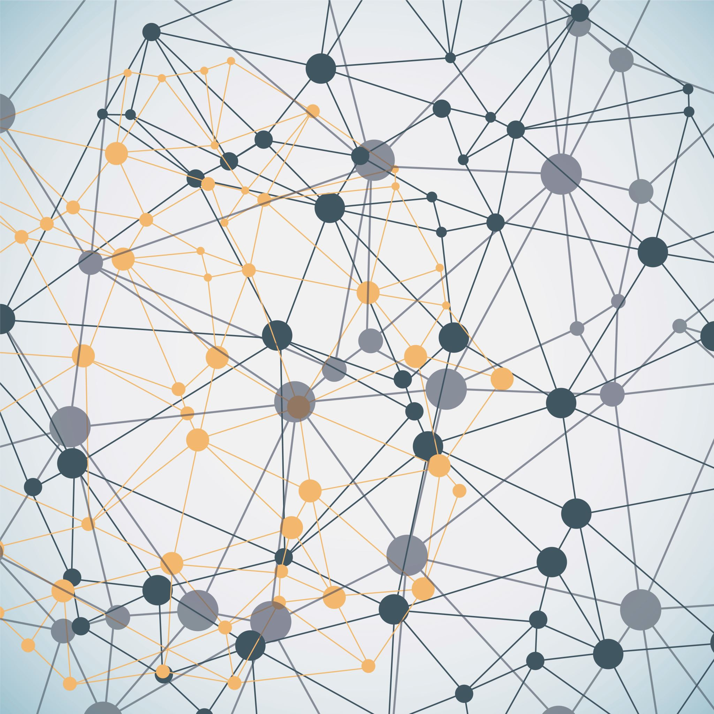
ASL translator
Ella Bar
Naomi Green
Daniella Simonovsky
Deep Learning Workshop

Slide 2

Problem Statement & Scope
Task: Isolated sign (word‑level) classification from video
Motivation: Help deaf and hearing people alike to learn a language they can share.
Input: video clip; Output: English word from fixed vocabulary

Slide 3
Dataset & Preprocessing
Datasets: WASL set from Kaggle, short clips by us
Preprocessing: Frame by frame conversion to pose keypoint data (body, face and hand positions) through MediaPipe. Normalization of median and deviation. Finally, frame-data stacking.
Enrichment: Sample mirroring.
Video sample
MediaPipe keypoints
Normalized pose vectors
Finalized sample tensors

Slide 4
Architecture: Keypoint-BiLSTM
Input (B, D, T) → LayerNorm → Linear(1629 → 256)
D = 1629 points of flattened MediaPipe pose data
BiLSTM: hidden 512, 2 layers, bidirectional (for GD), dropout 0.3 (regularization)
Rationale: smaller, faster, appearance-invariant vs. pixel CNNs

Slide 5
Training Setup
Optimizer: Adam, LR [0.001, 0.01] ; grad clipping 5.0 (for stability)
Batch size & epochs: set per hardware; model.eval() for validation
Best checkpoint on highest val metric; deterministic seeds (e.g., 1337)
DataLoader tuned for runtime (e.g., num_workers=2 on Colab)

Slide 6

Demonstration

Slide 7
Challenges
Lack of data
Available public resources did not contain enough samples for each word
We tried to focus on a few words with as many samples as we could find but it was still not enough.
Personal enrichment efforts are good but insufficient.
Overfitting
With this amount of data, there was no option but to overfit.

Slide 8
Conclusions & Next Steps
MediaPipe helped refine the data and speed up training
Too much weight was given to facial expressions since that is MediaPipe’s focus
Enrich data by an order of magnitude
Reduce weight of facial expressions
Expand vocabulary once more data is available

Slide 9
References
● Fang, Biyi &amp; Co, Jillian &amp; Zhang, Mi. (2017). DeepASL: Enabling Ubiquitous and Non-Intrusive Word and Sentence-Level Sign Language Translation. 10.1145/3131672.3131693.
● Baihan, A., Alutaibi, A.I., Alshehri, M. et al. Sign language recognition using modified deep learning network and hybrid optimization: a hybrid optimizer (HO) based optimized CNNSa-LSTM approach. Sci Rep 14, 26111 (2024). https://doi.org/10.1038/s41598-024-76174-7
● Camgoz, N. C., Koller, O., Hadfield, S., &amp; Bowden, R. (2020). Sign Language Transformers: Joint End-to-end Sign Language Recognition and Translation. In IEEE/CVF Conference on Computer Vision and Pattern Recognition (CVPR)
● M. Madhiarasan, Partha Pratim Roy (2022). A Comprehensive Review of Sign Language Recognition: Different Types, Modalities, and Datasets - https://arxiv.org/abs/2204.03328
● Y. S. Tan, K. M. Lim, and C. P. Lee, “Hand gesture recognition via enhanced densely connected convolutional neural network,”https://www.sciencedirect.com/science/article/pii/S0957417421002384
● R. Rastgoo, K. Kiani, and S. Escalera, “Sign language recognition: A deep survey,” https://doi.org/10.1016/j.eswa.2020.113794

